Slide 1
Static websites in 2018?
Application on legislative branch
Aleksandar Bošnjak
Geeks On Tour, 08/12/2018

Slide 2

Few words about me
Worked for 2 years as teaching assistant on Faculty of Technical Sciences, University of Novi Sad
First year of PhD studies, probably will be forever…
Proud member of Open Law Library crew, trying to make law accessible to anyone, for free !
Mostly intrested in code generators, and web technologies
created presentation last night

Slide 3
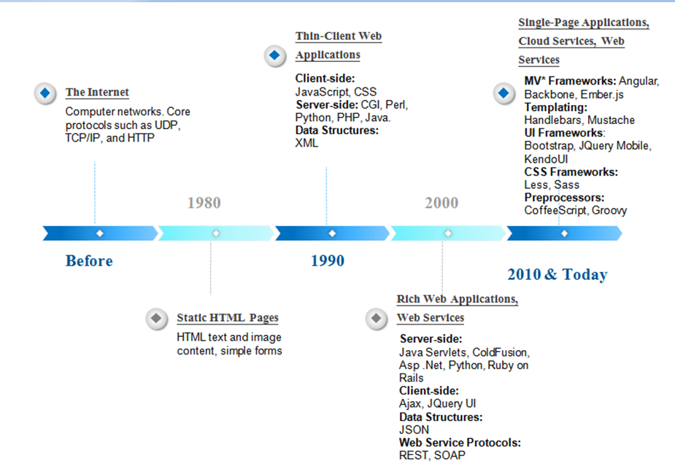
Evolution of web technologies
Quick overview of web technology evolution

Slide 4

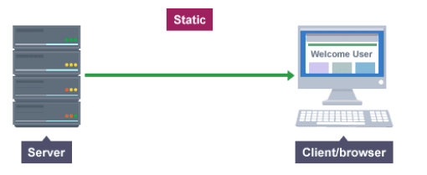
Static websites
File system
server outputs data “as is”
client request “resource”
An example of fetching “data” from static websites

Slide 5
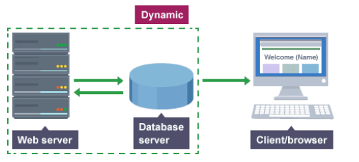

Dynamic websites
client request “resource”
generates dynamic response “on the fly”
An example of fetching “data” from dynamic websites

Slide 6
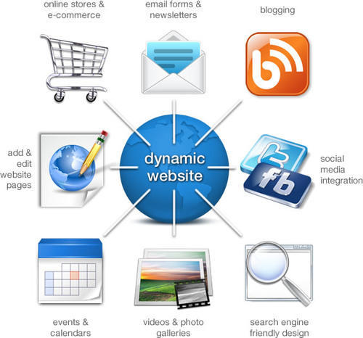
Dynamic websites / CMSs
e-commerce & online stores
email forms & newsletters
blogging
add & edit website pages
events and calendars
video and photo galleries
search engine friendly
social network websites
Some of many features supported by dynamic websites

Slide 7

Now that we have all of those features we couldn’t provide with static websites, why static websites in 2018?
“hmmmmmmmmmmmmm?”- pewdipie 2017/18 (not sure)

Slide 8

Static site generators
Simple view of static site generator, see more at: https://staticsitegenerators.net/

Slide 9
Static site generators
Reads user input and generates static HMTL and CSS pages (sometimes js and other assets based on concrete impl)
User input
is text based static file
is usually YAML, Markdown, XML, reST…
is supposed to be easily readable and editable by human
should be editable by any text editor
Website layout is defined by generator themes
Generator themes are usually written in open source templating languages like:
jinja
mustache
liquid
xslt
and many others…
Some generators are relying on front-end frameworks like (Gatsby – React, Nuxt.js – Vue.js…)

Slide 10
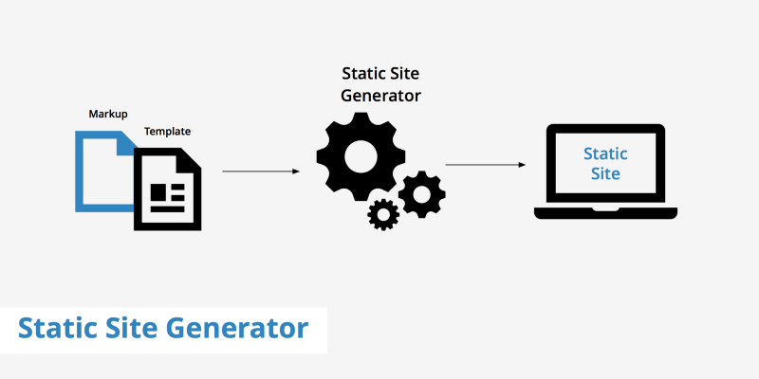
Static site generators
Simple view of static site generator

Slide 11
Static vs dynamic websites
static website
dynamic website
pros
performance
security
reliability
free hosting (usually GitHub, or similar)
simple
scalability
technological advancements
cons
losing interactivity with user (no profiles, favorites, suggestions etc.)
how long does it take to see the updated changes on the website? (generation time?)
pros
user interactivity (content generated per user)
supports complex features like login, payment, real-time updates and many others
cons
performance
security
hosting
3th party dependencies
expensive
complex

Slide 12

Well then, will generated static websites solve all our problems?
NO!

Slide 13
Choose the right weapon
dynamic websites
if our system is part of fast-changing category, where data is being updated in real-time
where page content depends on the current user
if there’s integration between multiple systems
and many others
static website
If our system is part of slow-changing category, where data is being updated from time to time
if we can store our data directly into static HTML pages, and update data periodically
an example: adding a post to the blog, adding or amending new law, etc.
when response time is on top of our priorities, and we cannot afford time to read data from some source and use that data to generate proper response per request
when security is on top of our priorities, hacking static websites? sounds challenging at least

Slide 14
Facts about performance expectations
73% of mobile internet users say that they’ve encountered a website that was too slow to load. »tweet«
51% of mobile internet users say that they’ve encountered a website that crashed, froze, or received an error. »tweet«
38% of mobile internet users say that they’ve encountered a website that wasn’t available. »tweet«
47% of consumers expect a web page to load in 2 seconds or less. »tweet«
40% of people abandon a website that takes more than 3 seconds to load. »tweet«
A 1 second delay in page response can result in a 7% reduction in conversions. »tweet«

Slide 15
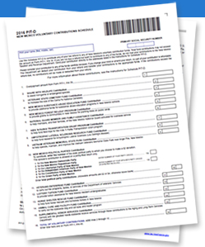
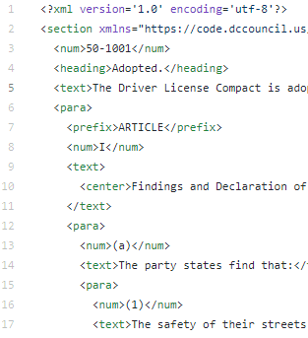
An example of xml-based static website generator for legislation use - intro
Laws, ordinances, regulations and statutes data is always provided in a document form
Since user input is document oriented, for data manipulation and control, we’ll use XML technologies
Many governments offer XML version of the laws
Representation of legal docs as XML documents

Slide 16
xml-based static website generator – technologies used
User input
XML documents
Generator development platform
python
Template language
XSLT
Output
HTML – generated as result of the XSLT transformation
CSS – predefined assets used by generated HTML
JS – predefined JavaScript snippets that will be used by HTML pages to support some user-interactivity features

Slide 17
xml-based static website generator - architecture
data editing
Creating new data based on existing
law docs
prepared input
data validation
RTF Documents
conversion
XML repository
data manipulation
copying all output assets
XSLT
Static website
CSS/JS generator theme
generator theme
covers HTML document structure
xml-based static website generator
General architecture of xml-based static website generator

Slide 18
Questions?

Slide 19



Thank you.
linkedin.com/in/aleksandar-bosnjak-812956101/
aleksandarbos.ns@gmail.com
github.com/aleksandarbos

Slide 20
References
Evolution of web technologies (http://justmobiledev.com/evolution-of-web-service-architectures/)
Basic static website functionalities (https://www.search3w.com/hello-world-2/)
Static and dynamic websites (http://www.learnwebskill.com/guide/static-website-dynamic-website, http://softcybernet.blogspot.com/2015/07/static-vs-dynamic-websites.html)
Do I need static website generator (https://blog.zipboard.co/do-i-need-a-static-site-generator-dd6f7e7e9e41)
How to start with static websites (https://blog.zipboard.co/how-to-start-with-static-sites-807b8ddfecc)
6 reasons why you should go for static website (https://dzone.com/articles/6-reasons-why-you-should-go-for-a-static-website)
Static site generator (https://www.keycdn.com/support/static-site-generator)

Slide 21
References
Why use a static generator (https://learn.cloudcannon.com/jekyll/why-use-a-static-site-generator/)
Do I need static generator? (https://blog.zipboard.co/do-i-need-a-static-site-generator-dd6f7e7e9e41)
Loading time expectations (https://neilpatel.com/blog/loading-time/)
Official Code of the DC Council (https://github.com/DCCouncil/dc-law-xml)
Open Law Library (http://openlawlib.org)

